Slide 1

AtliQ Hardwares
Ad Hoc business insights requests
By: João Pedro

Slide 2
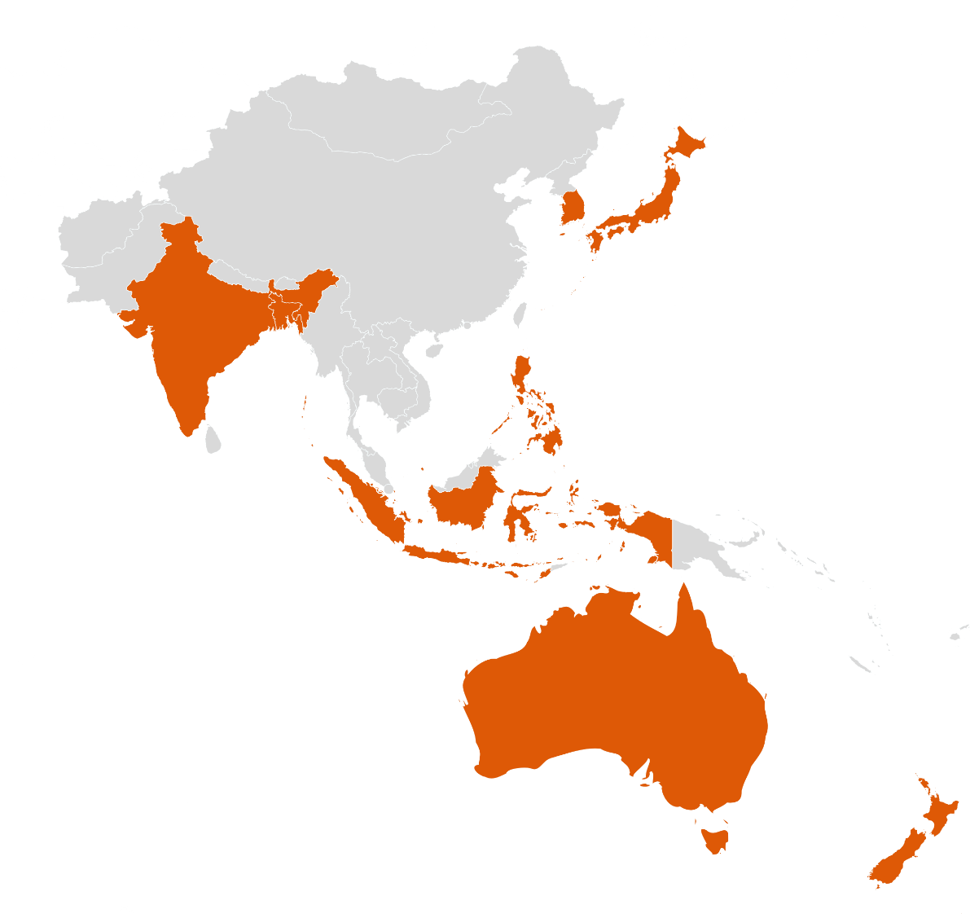
markets in which customer Atliq Exclusive operates it’s business in the APAC region.
market
Australia
Bangladesh
India
Indonesia
Japan
Newzealand
Philiphines
South Korea

Slide 3
What is the percentage of unique product increase in 2021 vs. 2020?
unique_products_2020 | unique_products_2021 | percentage_chg
245 | 334 | +36,33%

Slide 4
report with all the unique product counts for each segment and sort them in descending order of product counts
Number of unique products for each segment
segment | product_count
Notebook | 129
Accessories | 116
Peripherals | 84
Desktop | 32
Storage | 27
Networking | 9

Slide 5
Which segment had the most increase in unique products in 2021 vs 2020?
segment | product_count_2020 | product_count_2021 | difference
Desktop | 7 | 22 | 313%
Networking | 6 | 9 | 149%
Accessories | 69 | 103 | 148%
Storage | 12 | 17 | 141%
Peripherals | 59 | 75 | 126%
Notebook | 92 | 108 | 116%

Slide 6


Products that have the highest and lowest manufacturing costs
product_code | product | manufacturing_cost
A6120110206 | AQ HOME Allin1 Gen 2 | 240,54
A2118150101 | AQ Master wired x1 Ms | 0,89

Slide 7
report which contains the top 5 customers who received an average high pre invoice discount pct for the fiscal year 2021 and in the Indian market
customer_code | customer | average_discount_percentage
90002009 | Flipkart | 30,83%
90002006 | Viveks | 30,38%
90002003 | Ezone | 30,28%
90002002 | Croma | 30,25%
90002016 | Amazon | 29,33%

Slide 8
Gross sales amount for the customer Atliq Exclusive for each month
This analysis helps to get an idea of low and high-performing months and take strategic decisions

Slide 9
which quarter of 2020, got the maximum total sold quantity?
Quarter | total_sold_quantity
4 | 915.790.241
3 | 373.299.747
1 | 191.963.625
2 | 175.807.158

Slide 10
Which channel helped to bring more gross sales in the fiscal year 2021 and how Much it contibuted?
Channel | gross_sales_mln | percentage
Retailer | 705.532.519 | 73%
Direct | 150.664.256 | 16%
Distributor | 107.332.599 | 11%

Slide 11
Get the Top 3 products in each division that have a high total sold quantity in the fiscal year 2021
N&S Division
division | product_code | product | total_sold_quantity | rank_order
N & S | A6720160103 | AQ Pen Drive 2 IN 1 | 701.373 | 1
N & S | A6818160202 | AQ Pen Drive DRC | 688.003 | 2
N & S | A6819160203 | AQ Pen Drive DRC | 676.245 | 3

Slide 12
Get the Top 3 products in each division that have a high total sold quantity in the fiscal year 2021
P&A Division
division | product_code | product | total_sold_quantity | rank_order
P & A | A2319150302 | AQ Gamers Ms | 428.498 | 1
P & A | A2520150501 | AQ Maxima Ms | 419.865 | 2
P & A | A2520150504 | AQ Maxima Ms | 419.471 | 3

Slide 13
Get the Top 3 products in each division that have a high total sold quantity in the fiscal year 2021
PC Division
division | product_code | product | total_sold_quantity | rank_order
PC | A4218110202 | AQ Digit | 17.434 | 1
PC | A4319110306 | AQ Velocity | 17.280 | 2
PC | A4218110208 | AQ Digit | 17.275 | 3

